Slide 1

Hadoop: Basic Concepts
Mohd Hasnain(345346)

Slide 2
Think big - Big Data
3Vs
Predictive Analytics
Parallel Processing
NoSQL - Goodbye DBA?
  - Many others

Slide 3
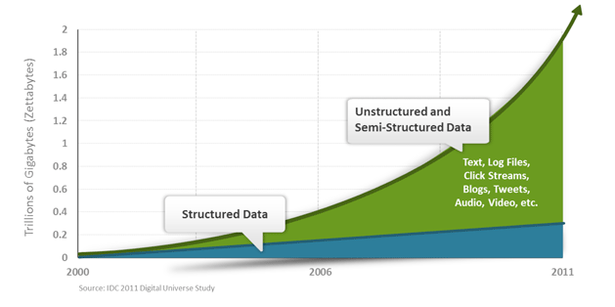
Data Worth Storing?
Transitions
Logs
Business
User
Sensor
Medical
Social
Sports
- etc ..
--- BigData Caught Flirting Everywhere

Slide 4
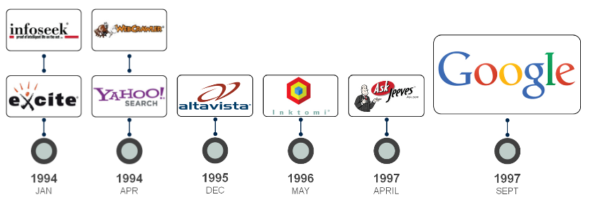
History of MapReduce
- Part of open source project nutch

Slide 5
Big Data Problem
VOLUME – TOO BIG
VELOCITY – TOO QUICK
VARIETY – TOO VARIABLE
-ANY ABOVE COMBINATION
‘BIG-DATA’ IS SIMILAR TO ‘SMALL-DATA’, BUT BIGGER

Slide 6
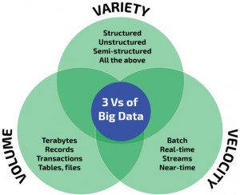
“Big data is when the normal application of current technology does not enable users to obtain timely, cost-effective, and quality answers to data-driven questions.”

Slide 7
Moore's law
The observation made in 1965 by Gordon Moore, co-founder of Intel, that the number of transistors per square inch on integrated circuits had doubled every year since the integrated circuit was invented.
Moore predicted that this trend would continue for the foreseeable future.
Embedding many smaller CPUs or "cores" onto the same physical device ??
This allows multiple threads to process twice as much data in parallel, but at the same speed at which they operated previously.
Hadoop is designed to efficiently process large volumes of information by connecting many commodity computers together to work in parallel.

Slide 8
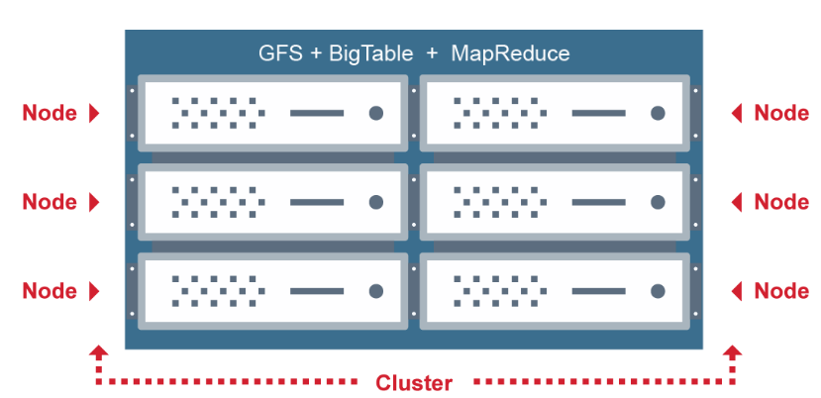
Google Big Data Problem Solution

Slide 9
Hadoop runs on commodity hardware
Example of suggested hardware specifications for a production Hadoop cluster is:
four 1TB hard disks in a JBOD (Just a Bunch Of Disks) configuration
two quad core CPUs, running at least 2-2.5GHz
16-24GBs of RAM (24-32GBs if you're considering HBase)
1 Gigabit Ethernet
Or, for a more powerful cluster
six 2TB hard disks, with RAID 1 across two of the disks
two quad core CPUs
32-64GBs of ECC (Error Correcting Code) RAM
2-4 Gigabit Ethernet

Slide 10
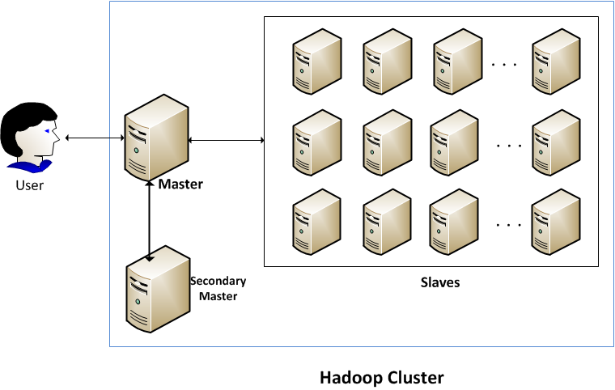
Cluster

Slide 11
Metadata “data about data"
data that describes other data
  Encryption type
  Data path, file path
  User group/access/author
  Replication factor
  Content type
  block size/file size
  Date created/modified
    Etc …

Slide 12
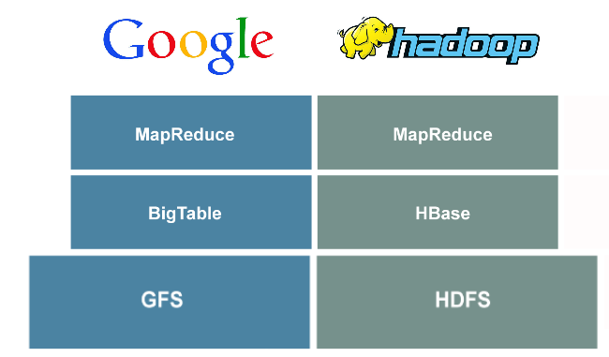
Hadoop - Doug cutting’s sons toy elephant

Slide 13
GFS
Designed to provide efficient, reliable access to data using large clusters of commodity hardware
Files are breaks into Chunk and distributed over nodes with replication
Multiple nodes - 1 Master node and a large number of Chunkservers
Parallel Processing – Divide and conquer
Distributed storage system
  If one break down add another
  If more data add another

Slide 14
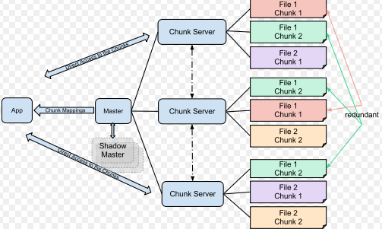
GFS Cont ..

Slide 15
Big Table
Not just a BIG table
Petabytes of data across thousands of commodity servers - distributed database
Distributed storage system for managing Semi structured data
Built on GFS – stores/extract
Ex…web indexing, Google Earth, and Google Finance
Not an RDBMS - not support joins nor does it support rich SQL-like queries
Each table is a three or multi dimensional map – map is indexed by row key, column key and timestamp
Why Time? – Allows capture same information over time without overriding preexisting entry

Slide 16
NoSQL – Not only SQL
- A Substitute for the Limitations of SQL?
Solve scalability and performance issues that RDBMS weren’t designed to address
3 V Problem - data is unstructured, unpredictable or needs to be massively processed in real time
Distributed transaction - one or more statements that, individually or as a group, update data on two or more distinct nodes of a distributed database
Unlimited read scalability
No global lock: transactions can work in parallel on different entries
Formats -Key-Value/Graph(Matrix)/Document/Big Table Databases
NoSQL is not a Standard

Slide 17
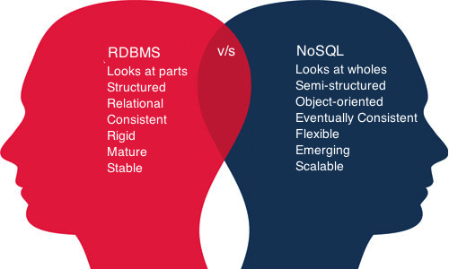

Slide 18
ACID vS BASE
- for database transactions
Atomic: Everything in a transaction succeeds or the entire transaction is rolled back.
Consistent: A transaction cannot leave the database in an inconsistent state.
Isolated: Transactions cannot interfere with each other.
Durable: Completed transactions persist, even when servers restart etc.
_____________________________________________________________
Basic Availability: Availability of data even in the presence of multiple failures
Soft-state: data consistency is the developer's problem and should not be handled by the database
Eventual consistency: The only requirement that NoSQL databases have regarding consistency is to require that at some point in the future, data will converge to a consistent state. No guarantees are made, however, about when this will occur.

Slide 19
CAP Theorem
Consistency – Atomic of ACID - operates fully or not at all
Availability – the service is available
Partition tolerance - the system will continue to work unless there is a total network failure. A few nodes can fail and the system keeps going.
- It’s harder to develop software in the fault-tolerant BASE world compared to the ACID world, but Brewer’s CAP theorem says you have no choice if you want to scale up.

Slide 20
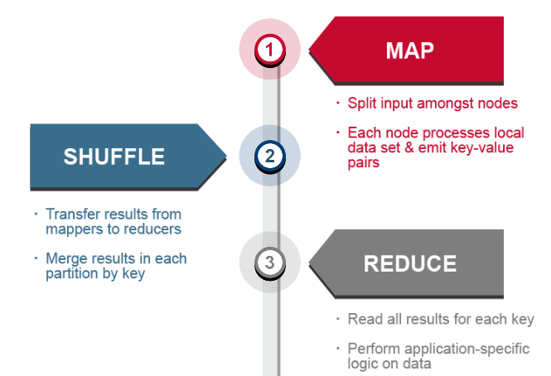
MapR Process

Slide 21
hadoop ecosystem
- CDH ( Cloudera Distribution Including Apache Hadoop)
Sqoop – RDBMS to HDFS
Flume – Instream to HDFS – example logs
Hive – SQL like – Runs MapR
Pig – Script – Runs MapR
Oozie – Task Mangement
Mahout – M/c learning on Hadoop
Drill/Impala - Low latency query – Directly HDFS
HBase is inspired from Google’s BigTable. It is a non-relational, scalable and fault-tolerant database that is layered on top of HDFS. HBase is written in Java.
ZooKeeper is a centralized service for maintaining configuration information, naming, providing distributed synchronization, and providing group services

Slide 22
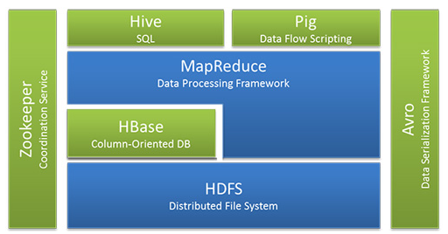

Slide 23
Summary ----
Ingest and Store Data in Original Format – No ETL ?
  - Transform Data when ready and move to EDW
  Provide more Cost effective/long term storage of Raw Data
  Reduced 90% EDW cost
  Save Data for Future Use (Instead of Use and Discard)
  Support Multi purpose use of large datasets
  Provide Recommendation Engine – Example music logs
  - to find item similarity job
  Hadoop Ecosystem

Slide 24

Thank you ☺

